Slide 1

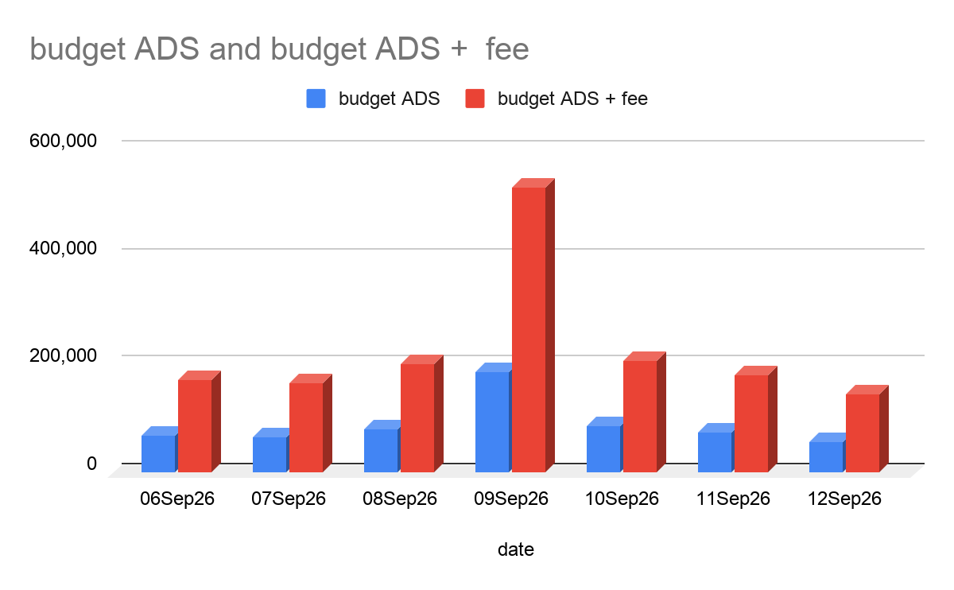
Budget ADS
date | budget ADS | budget ADS + fee
06Sep26 | 68,649 | 172,314
07Sep26 | 65,943 | 166,941
08Sep26 | 81,352 | 202,961
09Sep26 | 187,249 | 530,086
10Sep26 | 85,857 | 209,518
11Sep26 | 74,078 | 180,912
12Sep26 | 58,239 | 145,150
Note : Shopee fee 33% , Tiktok fee+discounts+refund 40%
Enjoy Your Detailing

Slide 2
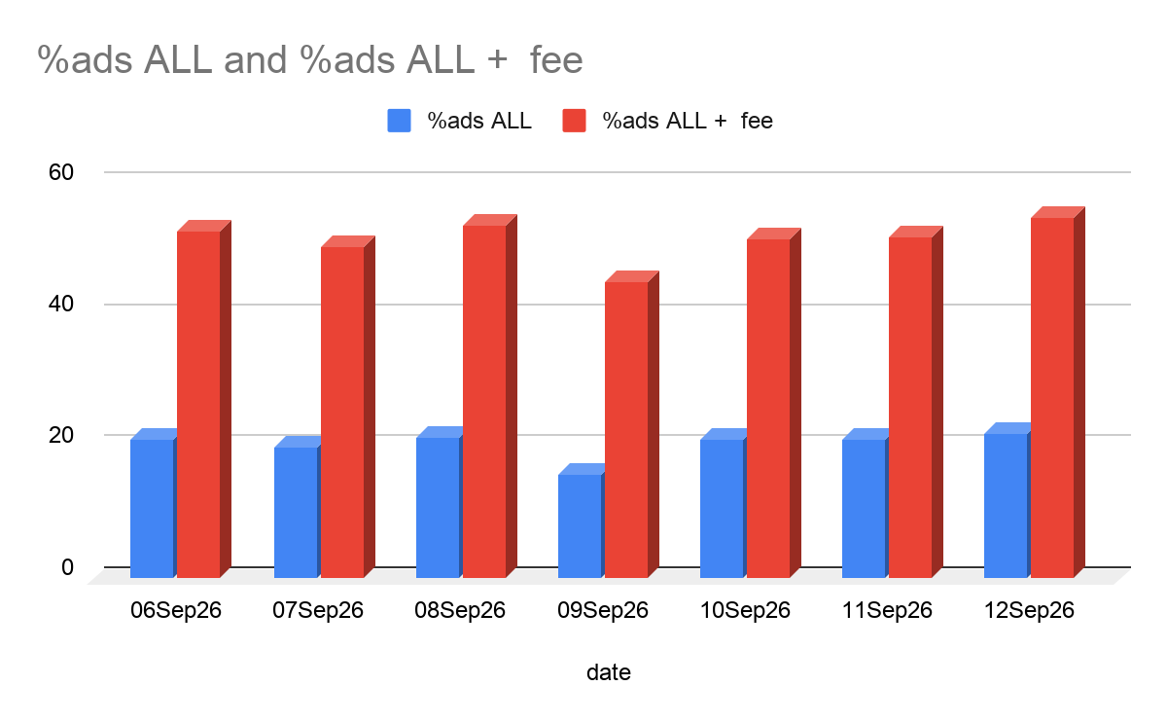
% Budget ADS
date | %ads ALL | %ads ALL + fee
06Sep26 | 20.99 | 52.68
07Sep26 | 19.83 | 50.21
08Sep26 | 21.46 | 53.53
09Sep26 | 15.91 | 45.03
10Sep26 | 21.12 | 51.55
11Sep26 | 21.24 | 51.87
12Sep26 | 21.95 | 54.70
Enjoy Your Detailing

Slide 3
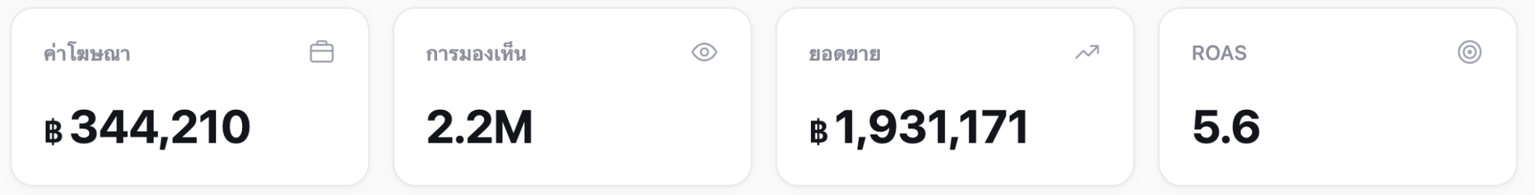
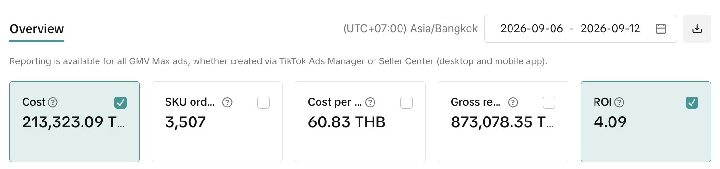
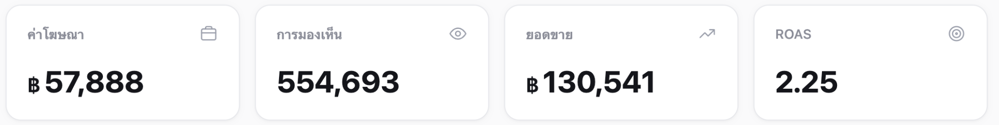
Shopee ADS+CPAS
Tiktok
Facebook ADS
Enjoy Your Detailing

Slide 4
Top product
1.Spot Clean
2.X-Glass
3.Interior
4.Duster
5.Sugar
6.Reflex
7.waterless
Enjoy Your Detailing

Slide 5
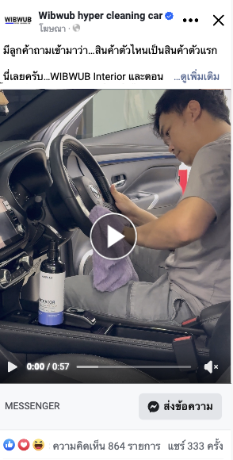
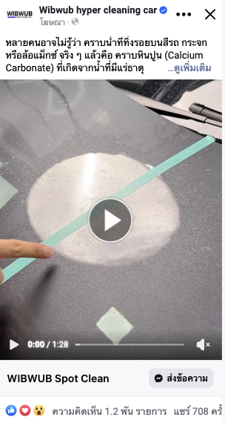
Top contents ADS (WIBWUB PAGE)
1.
2.
Enjoy Your Detailing

Slide 6

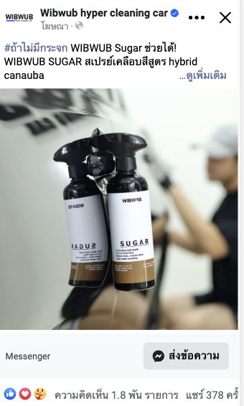
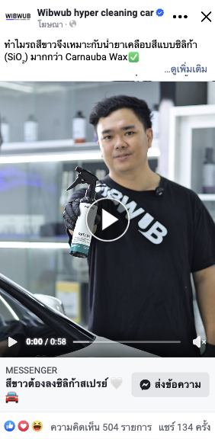
Top contents ADS (WIBWUB PAGE)
3.
4.
Enjoy Your Detailing

Slide 7
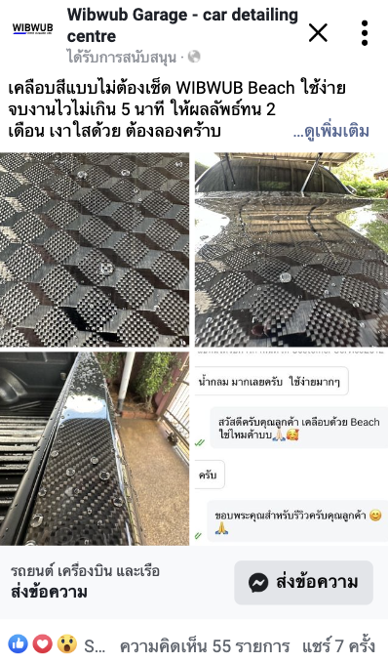
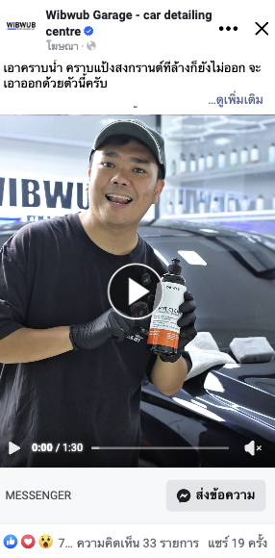
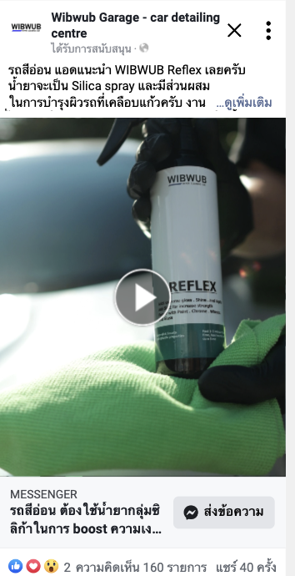
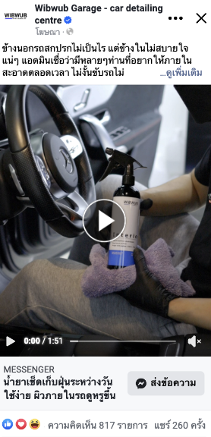
Top contents ADS (GARAGE PAGE)
1.
2.
Enjoy Your Detailing

Slide 8
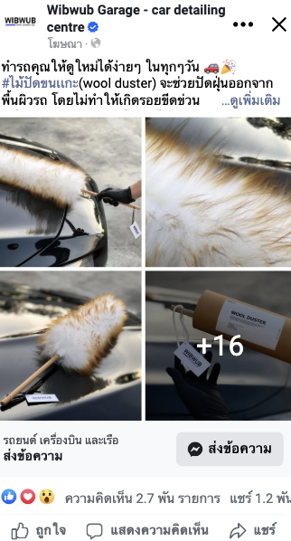
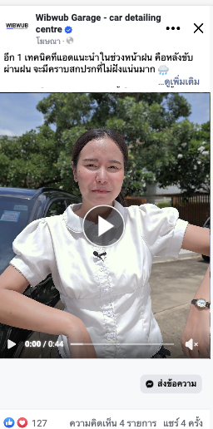
Top contents ADS (GARAGE PAGE)
3.
4.
Enjoy Your Detailing

